Slide 1
SS ZG 526: Distributed Computing
Peer-to-Peer Networks continued …
Chittaranjan Hota
Professor, Dept. of Computer Sc. & Information Systems
BITS, Pilani Hyderabad Campus, Hyderabad
hota@hyderabad.bits-pilani.ac.in

Slide 2

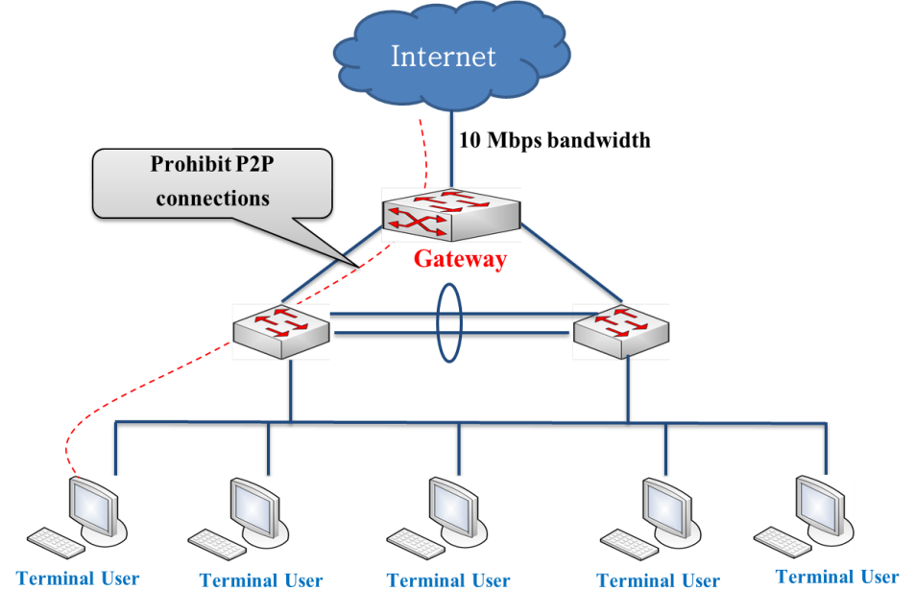
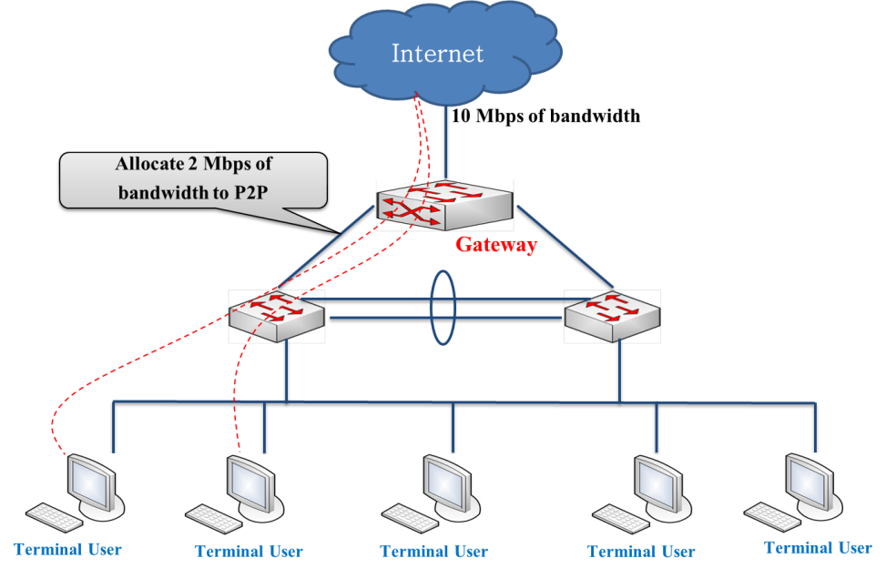
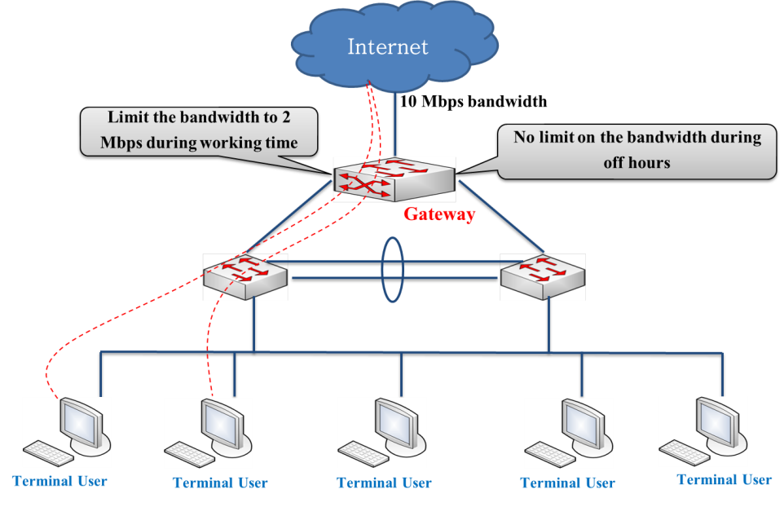
P2P Traffic Control
Birla Institute of Technology and Science, Pilani (Deemed University)

Slide 3



Trust Management
Centralized Peers
Peers
Super-peers
Peers
Ordinary
Peers
Fully
Decentralized P2P
Hybrid
P2P architecture
Birla Institute of Technology and Science, Pilani (Deemed University)

Slide 4

Identifying P2P traffic
Payload signatures and port-based
  Well-known port numbers (FastTrack: 1214, BitTorrent: 6881-6889, DC:411-412, Limewire: 6346/6347, Edonkey: 4662 etc)
  Payload signatures (GET /torrents/, …): Cisco’s PDML, Juniper’s netscreen IDP, Microsoft’s common application signatures, NetScout etc.
Traffic behavior based
  Source destination IP pairs that concurrently use both TCP and UDP.
  Failed connections.
  Server and Client behavior.
Birla Institute of Technology and Science, Pilani (Deemed University)

Slide 5
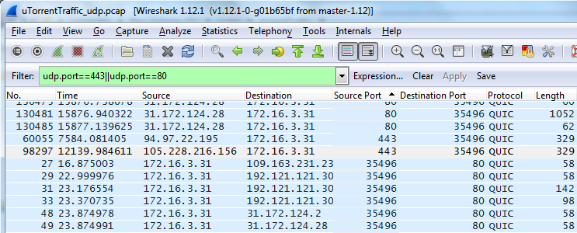

Usage of heuristics
UDP using 80 and 443
Birla Institute of Technology and Science, Pilani (Deemed University)

Slide 6
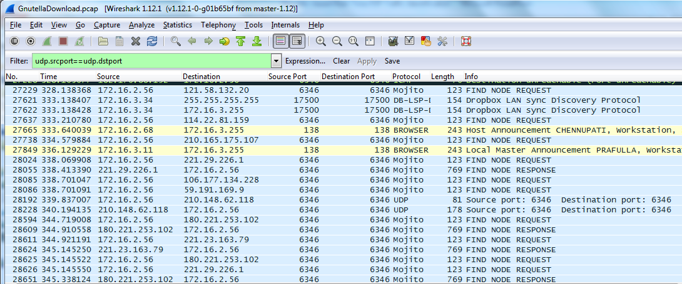

Continued…
FP
Same Source and Destination port numbers using UDP
Birla Institute of Technology and Science, Pilani (Deemed University)

Slide 7
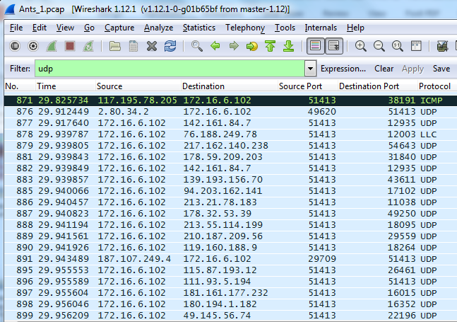

Continued…
Multiple Unique IPs and ports
Birla Institute of Technology and Science, Pilani (Deemed University)

Slide 8

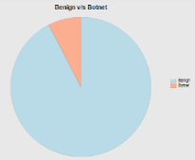
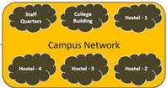
Machine learning Model for P2P detection
Parse packets
Filtered
traces
Extract Features
Training data
& knowledge
(features)
Machine learning
Statistical approaches
Expert knowledge
Entire network traffic
Enhanced knowledge
(subset of robust features)
Type 1
Dashboard
Type 2
Decision
ML model
…
Live traffic
Type n
Birla Institute of Technology and Science, Pilani (Deemed University)

Slide 9

Identifying Malicious P2P
Packet Validation and Filtering Module
Conversation Creation Module
Feature Set Extraction Module
Signal-processing
based features
P2P botnets identified
K-nn
REP trees
ANNs
SVMs
Extracted Features
Network-behavior based features
Valid packets
Discarded packets
Malicious conversation
Benign conversation
Birla Institute of Technology and Science, Pilani (Deemed University)

Slide 10
Next module
Cluster and Grid Computing
Birla Institute of Technology and Science, Pilani (Deemed University)

